Slide 1
SMART hOME Project

Slide 2
SMART hOME
Remoted controlled by Mobile Application.
For emergency cases or controlling without mobile, LCD and Keypad will be used “user mode only”.
The controllable things are 6 lamps “5 on/off lamps, one dimming lamp”, Opening or Closing Door, Viewing Temperature.
Admin mode can Add or Remove any user.
User mode can Use Lights and Air Conditioner

Slide 3
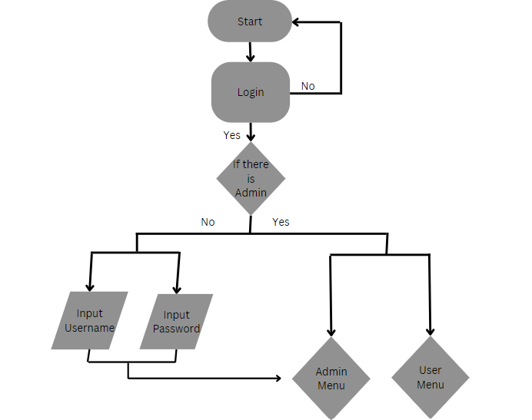
Flowcharts

Slide 4
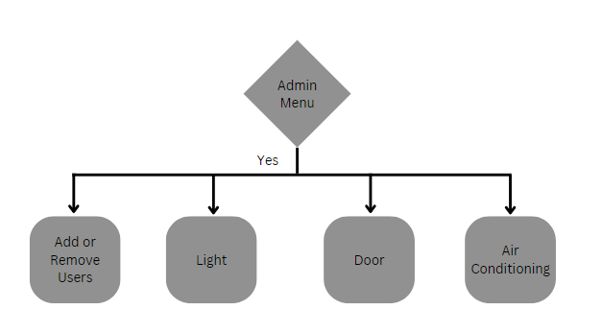
Flowcharts

Slide 5
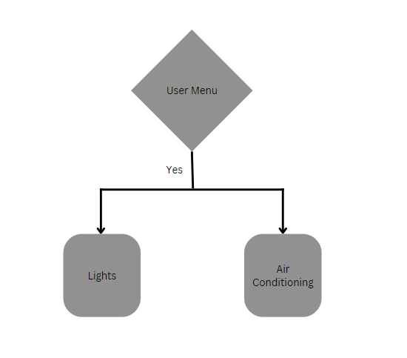
Flowcharts

Slide 6
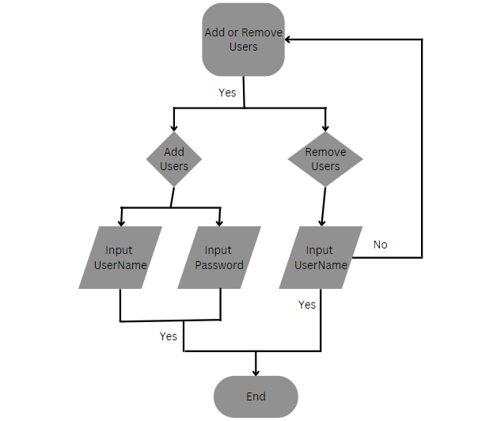
Flowcharts

Slide 7
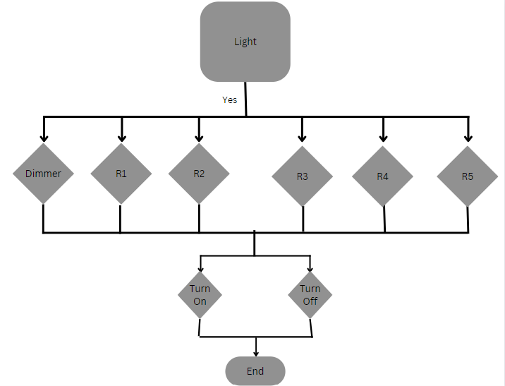
Flowcharts

Slide 8
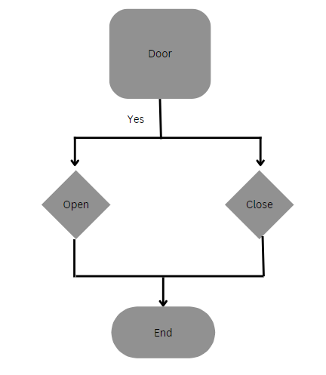
Flowcharts

Slide 9
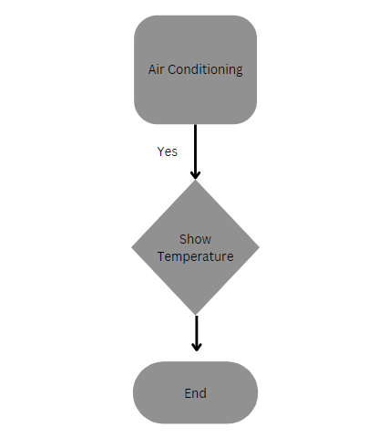
Flowcharts

Slide 10

Mahitab Waleed Shiref Khaled Karim Ashraf Ahmed Hossam Rawan Khaled Yassin Shebl

